Slide 1

A Secure Full Stack Voting System for Transparent, Reliable, and Scalable Digital Elections.
SDM Institute of Technology, Ujire
Department of Information Science and Engineering
First Review of Project Phase-1
A Presentation on
Under the Guidance of
Mrs. Leema Rachel Mathew (Assistant Professor)
Presented By
Deepak V S (4SU23IS010)
Prem T J (4SU23IS032)
Vignesha U G (4SU23IS060)
Vivek (4SU23IS061)

Slide 2
Agenda
Introduction
Literature Survey
Problem Statement
System Requirements
Objectives
Methodology
Outcomes
References

Slide 3
Abstract
This project presents a Secure Full Stack Voting System designed to make digital elections more transparent, reliable, and scalable. The system combines a user-friendly front end, a secure backend, and a robust database to ensure smooth voting operations. Strong authentication, encrypted data transfer, and tamper-proof vote storage protect the integrity of each vote.

Slide 4
Introduction
This system provides a secure and reliable platform for online elections, ensuring transparency by allowing voters to track their votes and providing a clear audit trail.
It is accessible to all voters, regardless of their technical skills or location, streamlining the voting process and reducing the time and effort required for conducting elections.

Slide 5
Literature Survey
Author(s) / Source | Published year | Brief Content Summary
Helios: Web-based Open-Audit Voting (Ben Adida) | 2008 | Helios is one of the first web-based e-voting systems that allow voters to verify their vote without revealing their identity. It uses cryptographic proofs to ensure that votes are encrypted, counted correctly, and remain private.
Blockchain-Based Secure E-Voting System (Alaa K.Ayed) | 2017 | This model eliminates the need for a central authority by recording each vote on a blockchain network. Smart contracts automatically handle vote submission and counting, ensuring immutability and transparency in the election process.
Design of a Secure Online Voting System Using Biometric Authentication(N. Kumar, S. Dutta) | 2016 | Integrates fingerprint verification to validate voter identity. Prevents impersonation and multiple voting using biometric data stored securely in databases.(Optional)

Slide 6
Literature Survey
Author(s) / Source | Published year | Brief Content Summary
A Blockchain-Based E-Voting System Using Smart Contracts (A. Shuaib, S. Musa, M. Idris) | 2020 | Implements a blockchain voting model on Ethereum using Solidity. Votes are stored as immutable transactions, achieving tamper-proof storage and transparent vote counting.
Secure E-Voting System Using OTP Authentication(A. Hussain, F. Rahman, M. Khan) | 2021 | Uses OTP-based two-factor authentication for secure voter verification. Ensures one-vote-per-user policy and enhances backend security through dynamic OTP generation.
Cloud-Based E-Voting Systems (L. Chen, H. Zhang) | 2018 | Proposes deploying voting systems on cloud servers for better scalability and reliability. Enhances performance and storage security with cloud infrastructure.

Slide 7
Literature Survey
Author(s) / Source | Published year | Brief Content Summary
Usability Challenges in Electronic Voting Systems (Robert Krimmer, Melanie Volkamer, Melanie Brucker) | 2017 | Analyzes the importance of usability and interface design in electronic voting. Discusses how UI/UX impacts voter confidence, trust, and accessibility.
ElectAnon: Anonymous Blockchain Voting Protocol (H. Onur, A. Yurdakul) | 2022 | Introduces a ranked-choice voting protocol on blockchain ensuring privacy and scalability. Highlights use of cryptography for voter anonymity.
End-to-End Verifiable Internet Voting(Ronald L. Rivest, John Wack) | 2006 | Introduces the concept of end-to-end verifiability, ensuring every voter can confirm that their encrypted vote was correctly included in the final tally without revealing who they voted for.

Slide 8
Problem Statement
Voter fraud and tampering undermine trust in the electoral process.
Limited accessibility, especially for disabled or remote voters, creates inequality and excludes portions of the population. Digital divides and complex user interfaces alienate some voters.

Slide 9
Poor accessibility, especially for disabled or remote voters, creates inequality in participation. Digital divides and interface complexity further sections of the population.
System resilience is vital to withstand cyberattacks, outages, or manipulations. A fragile system can be easily disrupted, compromising the entire election process.

Slide 10
System Requirements
Software Requirements:
Operating System
Web Server
Frontend & Backend Tech.
Database

Slide 11
Objectives
The objectives of the proposed work are
Protect voter anonymity while ensuring only eligible voters participate and Remove reliance on centralized authorities.
Enhance transparency and minimize fraud and errors. Provide a scalable platform trusted by diverse communities.

Slide 12
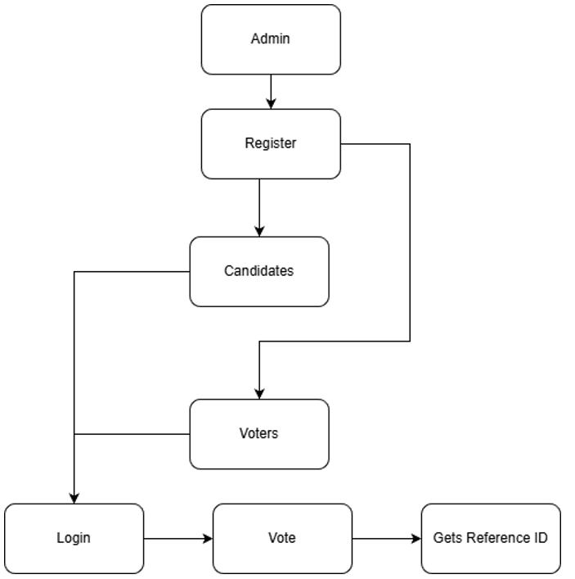
Methodology

Slide 13
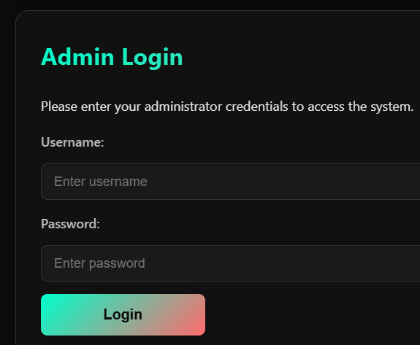
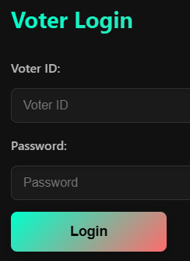
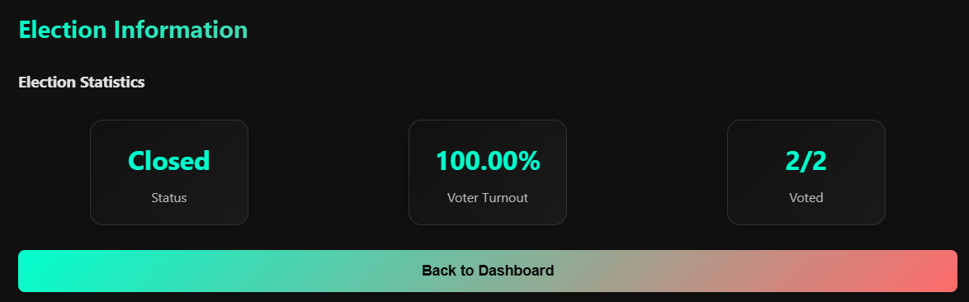

Slide 14
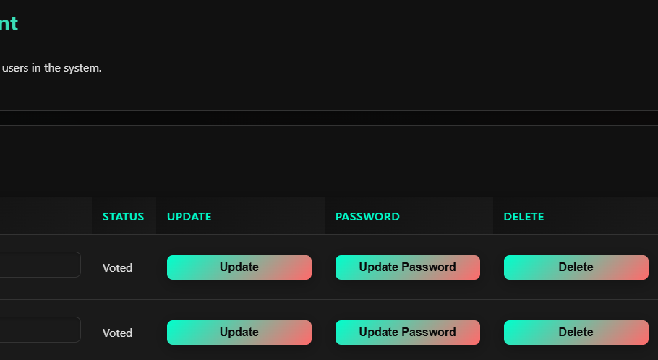
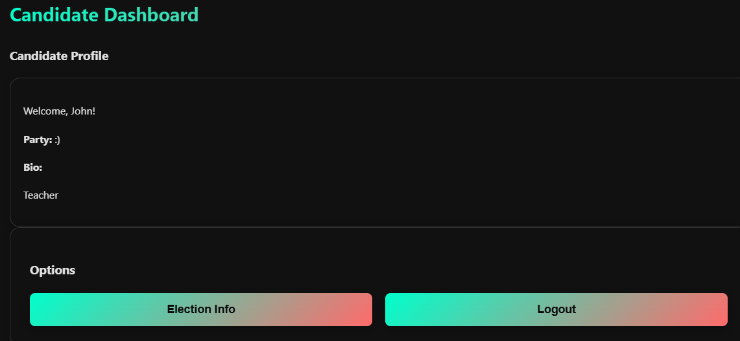
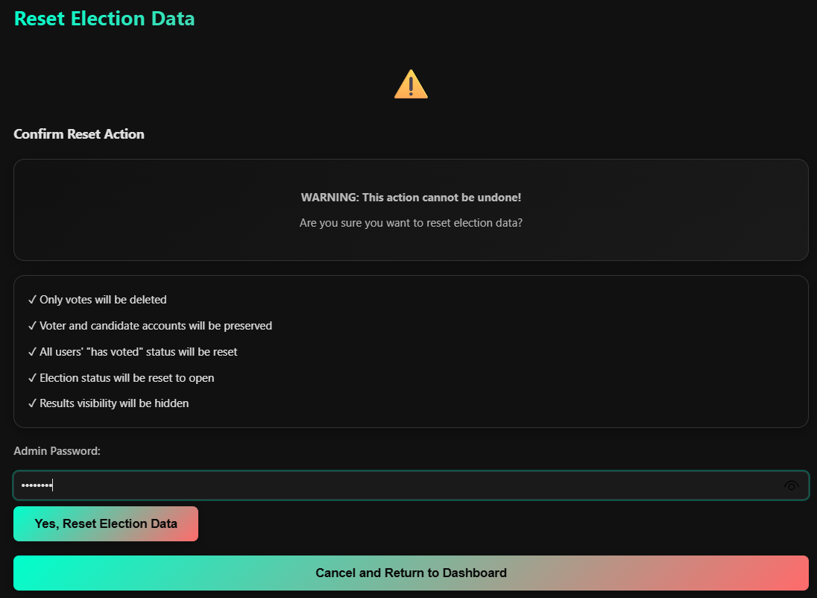
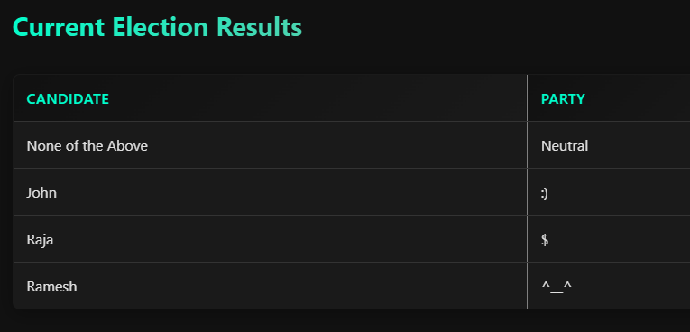

Slide 15
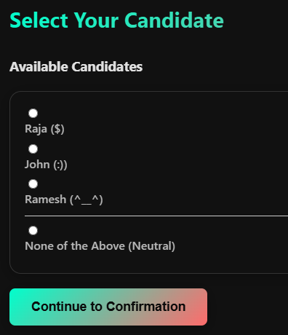
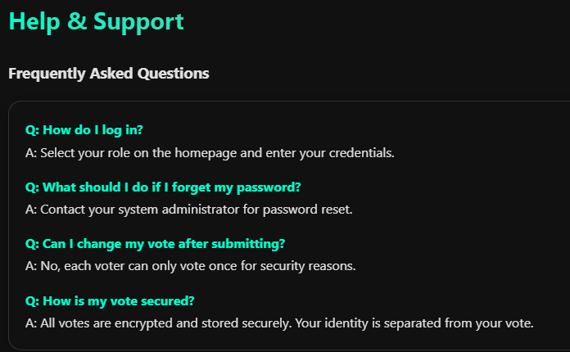

Slide 16
Outcomes
The outcomes of the proposed work are
Security & Authentication – Strengthened voter identity verification ensures secure and tamper-proof elections.
Real-time tracking boosts transparency and speeds up result processing.
Accessibility & Inclusion – Simplified interfaces allow broader voter participation, increasing turnout.

Slide 17
Conclusion
The Secure Full Stack Voting System successfully demonstrates how modern technology can transform traditional elections into a transparent, reliable, and scalable digital process. By integrating secure authentication, encrypted vote storage, real-time counting, and audit mechanisms, the system ensures high levels of security, accuracy, and trust.

Slide 18
References
References of conference/journal paper or books or website in the specified below
[1] Adida, B. (2008). "Helios: Web-Based Open-Audit Voting." Proceedings of the 17th USENIX Security Symposium, 335-348.
[2] Rivest, R. L., Smith, W. D. (2007). "Three Voting Protocols: ThreeBallot, VAV, and Twin." Proceedings of the 2007 Electronic Voting Technology Workshop.
[3] Bonneau, J., Herley, C., Van Oorschot, P. C., Stajano, F. (2012). "The Quest to Replace Passwords: A Framework for Comparative Evaluation of Web Authentication Schemes." IEEE Symposium on Security and Privacy, 553-567.

Slide 19
[1] Adida, B. (2008). "Helios: Web-Based Open-Audit Voting." Proceedings of the 17th USENIX Security Symposium, 335-348.
[2] Rivest, R. L., Smith, W. D. (2007). "Three Voting Protocols: ThreeBallot, VAV, and Twin." Proceedings of the 2007 Electronic Voting Technology Workshop.
[3] Bonneau, J., Herley, C., Van Oorschot, P. C., Stajano, F. (2012). "The Quest to Replace Passwords: A Framework for Comparative Evaluation of Web Authentication Schemes." IEEE Symposium on Security and Privacy, 553-567.
[3] Bonneau, J., Herley, C., Van Oorschot, P. C., Stajano, F. (2012). "The Quest to Replace Passwords: A Framework for Comparative Evaluation of Web Authentication Schemes." IEEE Symposium on Security and Privacy, 553-567.

Slide 20
14. ‘Thank You’ Slide (1 slide)
Just mention ‘THANK YOU’ on this slide.
Include ‘QUESTIONS?’ If you want.
THANK YOU

